Slide 1
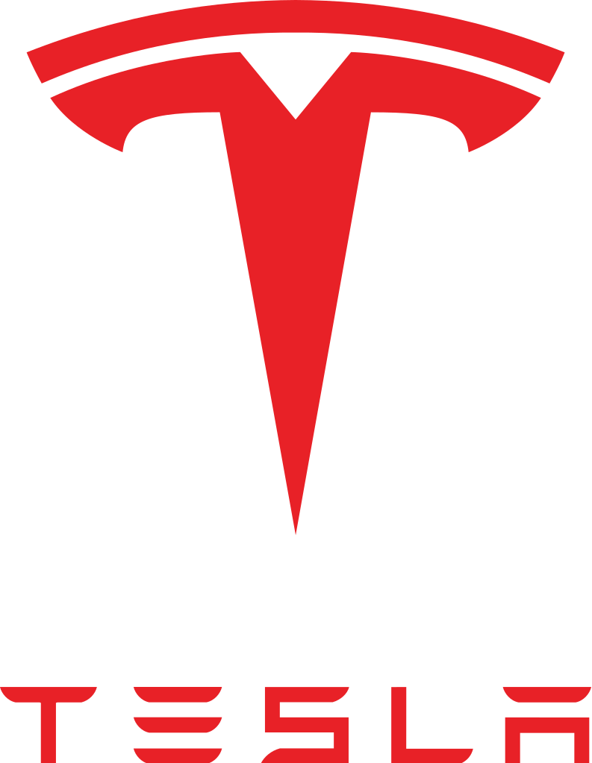
Tesla
“Sustainable Transport
electric tehnology”

Slide 2
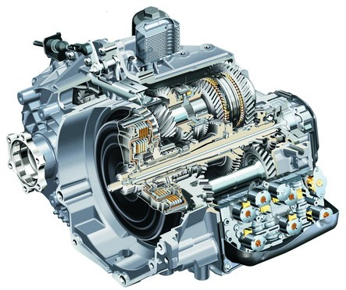
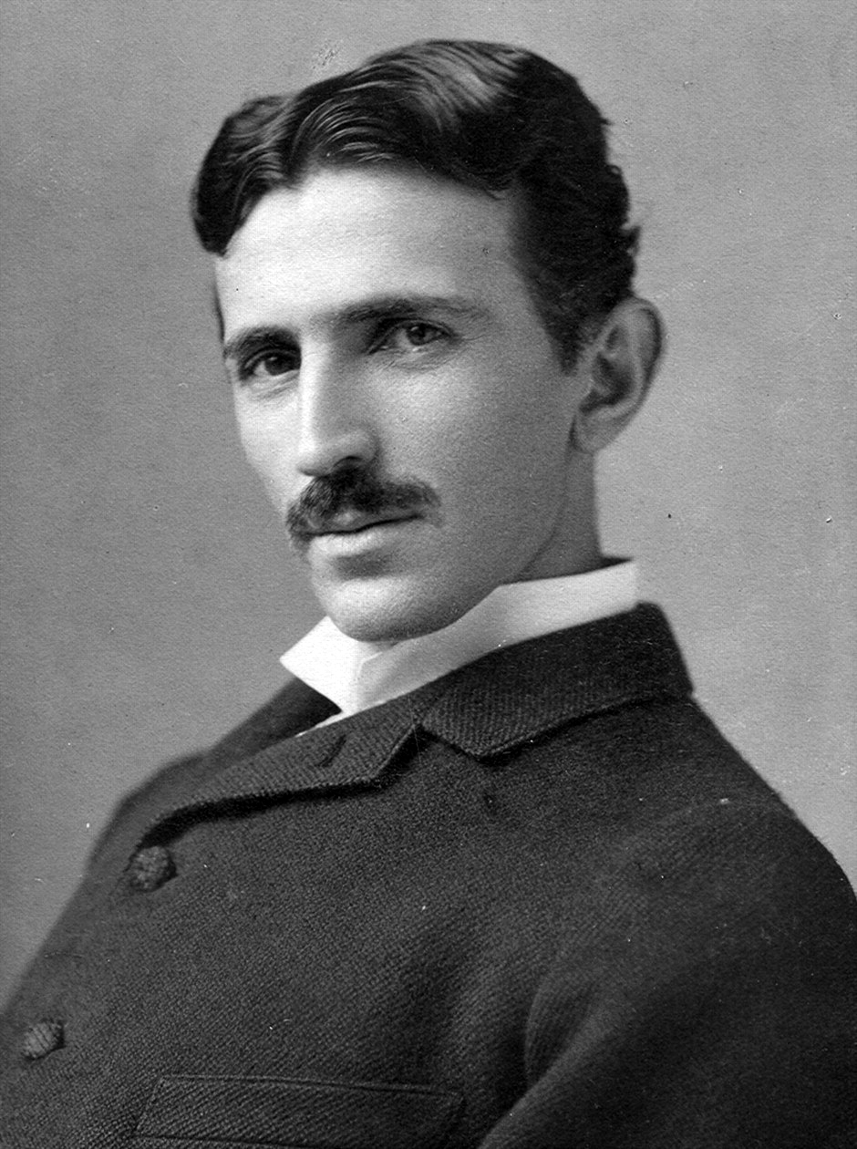
Overview
Tesla is named after the electrical engineer and physicist Nikola Tesla.
Nikola was best known for his contribution to the design of the modern alternating curect (AC) electricity supply system.
Tesla is an American company that designs, manufacters and sell electric cars and electric behicle powertrain components.

Slide 3
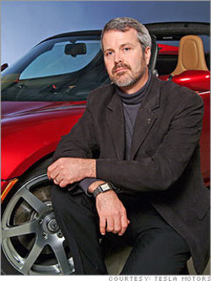
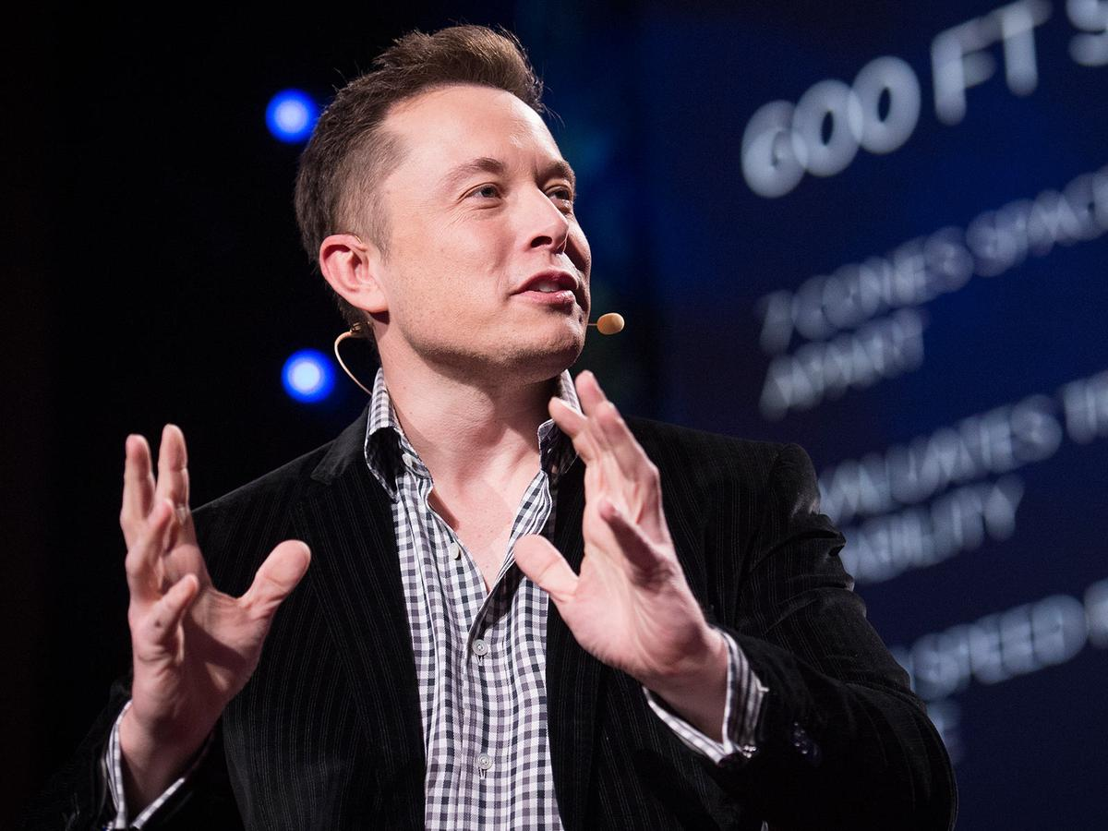
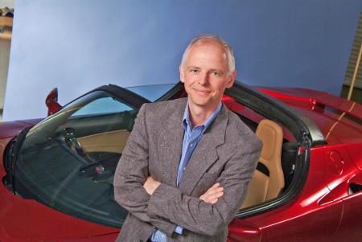
History
Founded in 2003 by Elon Musk, Martin Eberhard, and Marc Tarpenning in Silicon Valley
March 2008- Tesla beging production of Roadster and sells about 2000 of them.
Jan 2010- Tesla register for an IPO
May 2010- Tesla buy former GM factory in Fremont, CA and Toyota signs deal to cooperate in EV development

Slide 4
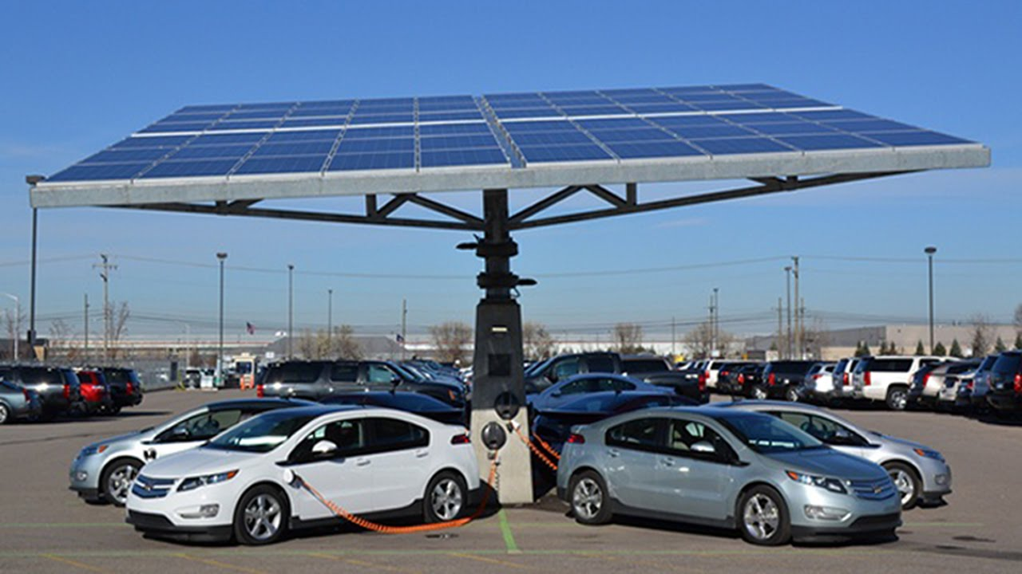
Why Tesla?
Biggest opportunity for growth
Elon Musk’s proven leadership (Paypal and SpaceX)
Appleizing the car industry
New form of selling cars with no dealerships
Prove to transform the market, first to produce electric cars relatively cheaply

